Slide 1
Session 25:
Exception Handling
Dr. Naveen Kumar
Associate Professor
Amity Institute of Information Technology
Amity University Patna

Slide 2
Exception Handling
Abnormal termination called Exception.
An exception is raised due risky code.
An exception is an event that occurs during execution of the program that disturbs normal flow of the program instructions.
If the application contains exception then the program terminated abnormally then the rest of the application is not executed.
To overcome above limitation the program need to be executed in smooth manner & to get normal termination of the application we must handle the exception properly.
There are two ways to handle the exceptions in java.
1) By using try-catch block.
2) By using throws keyword.

Slide 3
Reasons for exceptions
opening a non-existing file.
Network connection problems.
Values are out of range values.
End user input mistakes.......etc
Exception Handling:-
The main objective of exception handling is to get normal termination of the application in order to execute rest of the application code.
Exception handling means to providing alternate code to continue the execution of remaining code & to get normal termination of the application.

Slide 4
Every Exception is a predefined class present in different packages.
java.lang.ArithmeticException java.lang
java.io.IOException java.io
java.sql.SQLException java.sql
javax.servlet.ServletException javax.servlet
Types of Exceptions:-
As per the sun micro systems standards The Exceptions are divided into three types
1) Checked Exception
2) Unchecked Exception
3) Error

Slide 5
Checked Exception
The Exceptions which are checked by the compiler at the time of compilation are called Checked Exceptions.
Examples:- IOException, SQLException, InterruptedException, ClassNotFoundException........etc
If the application contains checked Exception the compiler is able to check it and it will give intimation to developer regarding Exception in the form of compilation error.
Handle the checked Exception in two ways
By using try-catch block.
By using throws keyword.

Slide 6
Checked Exception
In our application whenever we are using exceptional methods the code is not compiled because these methods throws checked exception hence must handle the exception by using try-catch or throws keywords.
Note: - If application contains checked Exception then at the compile time compiler displays exception information for handling the exception but the exception raised at runtime if the required resources are not available.

Slide 7
Checked Exception
1) java.lang.InterruptedException
When we use Thread.sleep(2000); your thread is entered into sleeping mode then other threads are able to interrupt the program is terminated abnormally & rest of the application is not executed.
To overcome above problem compile time compiler is checking that exception & displaying exception information in the form of compilation error.
Based on compiler generated error message write the try-catch blocks or throws , if runtime any exception raised the try-catch or throws keyword executed program is terminated normally.
2) Java.io.FileNotFoundException
If we are trying to read the file from local disk but at runtime if the file is not available then program is terminated abnormally rest of the application is not executed.
To overcome above problem compile time compiler is checking that exception & displaying exception information in the form of compilation error.
Based on compiler generated error message write the try-catch blocks or throws , if at runtime any exception raised the try-catch or throws keyword executed program is terminated normally.

Slide 8
Checked Exception
3) Java.sql.SQLException
If we are trying to connect to database but at runtime data base is not availablethen program is terminated abnormally rest of the application is not executed.
Note: In above scenarios compile time compiler is display just exception information but exception raised at runtime.

Slide 9
FileNotFoundException
import java.io.File;
import java.io.FileNotFoundException;
import java.util.Scanner;
public class FileNotFoundExceptionExample {
public static void main(String[] args) {
File file = new File("nonexistent_file.txt");
Scanner scanner = new Scanner(file);
}
}

Slide 10
IOException
import java.io.BufferedReader;
import java.io.FileReader;
import java.io.IOException;
public class IOExceptionExample {
public static void main(String[] args){
BufferedReader reader = null;
reader = new BufferedReader(new FileReader("nonexistent_file.txt"));
String line;
while ((line = reader.readLine()) != null) {
System.out.println(line);
}
reader.close();
}
}

Slide 11
ClassNotFoundException
public class ClassNotFoundExceptionExample {
public static void main(String[] args) {
Class<?> clazz = Class.forName("com.example.NonExistentClass");
}
}

Slide 12
SQLException
import java.sql.Connection;
import java.sql.DriverManager;
import java.sql.SQLException;
public class SQLExceptionExample {
public static void main(String[] args) {
Connection connection = DriverManager.getConnection("jdbc:mysql://localhost:3306/mydatabase", "username", "password");
}
}

Slide 13
ParseException
import java.text.DateFormat;
import java.text.ParseException;
import java.text.SimpleDateFormat;
import java.util.Date;
public class ParseExceptionExample {
public static void main(String[] args) {
DateFormat dateFormat = new SimpleDateFormat("yyyy-MM-dd");
String invalidDate = "2023-13-45";
Date parsedDate = dateFormat.parse(invalidDate);
System.out.println("Parsed date: " + parsedDate);
}
}

Slide 14
InterruptedException
public class InterruptedExceptionExample {
public static void main(String[] args) {
Thread.sleep(5000);
}
}

Slide 15
MalformedURLException
import java.net.MalformedURLException;
import java.net.URL;
public class MalformedURLExceptionExample {
public static void main(String[] args) {
String invalidURL = "htp://example.com";
URL url = new URL(invalidURL);
System.out.println("Valid URL: " + url.toString());
}
}

Slide 16
import java.io.*; class Test { public static void main(String[] args)
{ File f = new File("abc.txt"); FileReader fr = new FileReader(f);
} }
If you are trying to compile the above compilation the compiler will show the compilation error.
C:\>javac Test.java Test.java:5: error: unreported exception FileNotFoundException; must be caught or declared to be thrown
FileReader fr = new FileReader(f);

Slide 17
Unchecked Exception
The exceptions which are not checked by the compiler at the time of compilation are called unchecked Exception.
ArithmeticException,ArrayIndexOutOfBoundsException,NumberFormatException....etc
If the application contains un-checked Exception then the code is compiled but at runtime JVM (Default Exception handler) display exception message then program terminated abnormally.
To overcome runtime problem must handle the exception in two ways.
By using try-catch blocks.
By using throws keyword.

Slide 18
class Test { public static void main(String[] args)
{ int[] a ={10,20,30}; System.out.println(a[6]);
} }
C:\>java Test Exception in thread "main" java.lang.ArrayIndexOutOfBoundsException: 6
Note-1:- Whether it is a checked Exception or unchecked exception, exceptions are raised at runtime but not compile time.
Note-2:- In java whether it is a checked Exception or unchecked Exception must handle the Exception by using try-catch blocks or throws keyword to get normal termination of application & to execute rest of the application.

Slide 19
Exception vs Error
The exception are occurred due to several reasons
a. Developer mistakes
b. End-user input mistakes.
c. Resource is not available
d. Networking problems.
Exceptions are caused to several reasons like developer mistakes, end user input mistakes, network problems. But error is caused due to lack of system resources.
Example: - StackOverFlowError, OutOfMemoryError, AssertionError............etc
It is possible to handle the exceptions by using try-catch blocks or throws keyword but it is not possible to handle the errors.
Error is an un-checked type exception.

Slide 20
Example:-
class Test
{ public static void main(String[] args)
{ Test[] t = new Test[100000000];
} };
Exception in thread "main" java.lang.OutOfMemoryError: Java heap space
In tree Structure RuntimeException its child classes & Error its child classes are Unchecked Exception remaining all exceptions are checked Exceptions.
The root class of exception handling is Throwable class.

Slide 21
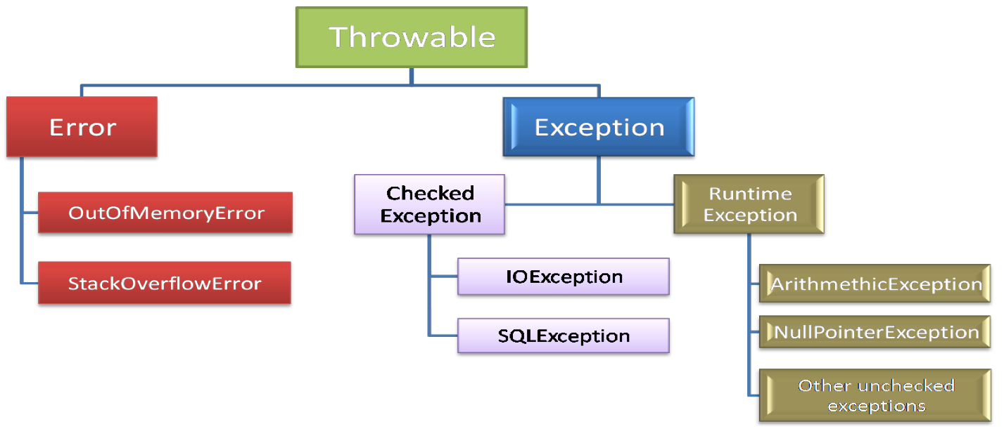

Slide 22
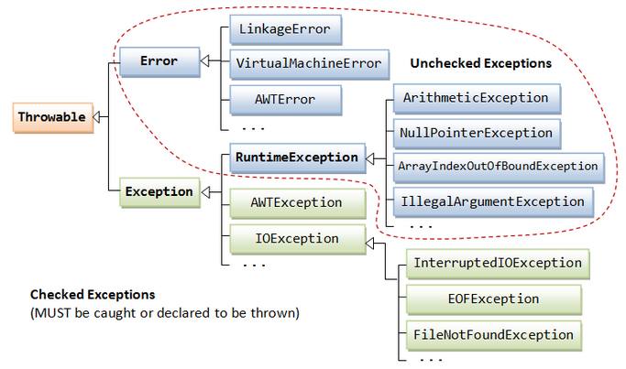

Slide 23
Fully Checked vs Partially Checked
The root class & all its child class are checked then that root class is called fully checked exception.
Example :- IOException,SQLException....etc
The root class contains some child classes are checked exceptions & some child classes are un-
checked exception then that root class is called partially checked exception. Example :- Exception , Throwable..etc

Slide 24
Exception handling key words
1) try
2) catch
3) finally
4) throw
5) throws
There are two ways to handle the exceptions in java.
1) By using try-catch block.
2) By using throws keyword.

Slide 25
Exception handling by using Try –catch blocks
Syntax:-
try {
exceptional code;
} catch (ExceptionName reference_variable) {
Code to run if an exception is raised (alternate code);
}

Slide 26
Application without try-catch blocks
class Test
{ public static void main(String[] args)
{ System.out.println("ratan"); System.out.println(10/0);
System.out.println("rest of the application");
} }
C:\>java Test
Exception in Thread “main” java.lang.ArithmeticException: / by zero
Handled by JVM type of the Exception. description
In above example exception raised program is terminated abnormally & rest of the application is not executed.
Whenever the exception raised the default exception handler is responsible to handle the exception & it is component of the JVM.

Slide 27
Application with try-catch blocks
Whenever the exception is raised in the try block JVM won’t terminate the program immediately it will search corresponding catch block.
If the catch block is matched then that block will be executed & rest of the application executed & program is terminated normally.
If the catch block is not matched program is terminated abnormally.
class Test
{ public static void main(String[] args) { System.out.println("ratan");
try { System.out.println(10/0); } catch (ArithmeticException ae) { System.out.println(10/2); } System.out.println("rest of the application");
} }

Slide 28
Application with try-catch blocks
E:\>java Test ratan 5 rest of the application
In above example we are handling exception by using try-catch block hence the program is terminated normally & rest of the application is executed.

Slide 29
1.a Application without try-catch blocks
class Test{
public static void main(String[] args){
System.out.println("ratan");
System.out.println(10/0);
System.out.println("rest of the application");
}
}

Slide 30
1.b Whenever the exception is raised in the try block JVM won’t terminate the program immediately it will search corresponding catch block.
a. If the catch block is matched then that block will be executed & rest of the application executed & program is terminated normally.
b. If the catch block is not matched program is terminated abnormally.
class Test{
public static void main(String[] args) { System.out.println("ratan");
try{
System.out.println(10/0);
}
catch (ArithmeticException ae){
System.out.println(10/2);
}
System.out.println("rest of the application");
}
}

Slide 31
1. catch block is not matched hence program is terminated abnormally.
class Test
{ public static void main(String[] args)
{ try
{ System.out.println("sravya");
} }
System.out.println(10/0);
}
catch(NullPointerException e)
{ System.out.println(10/2);
}
System.out.println("rest of the app");
}}
C:\sravya>java Test
sravya
Exception in thread "main" java.lang.ArithmeticException: / by zero

Slide 32
2. If there is no exception in try block the corresponding catch blocks are not checked.
class Test{
public static void main(String[] args){
try{
System.out.println("sravya");
System.out.pri ntln("anu");
}
catch(NullPointerException e)
{ System.out.println(10/2);
}
System.out.println("rest of the app");
}
}

Slide 33
3. In Exception handling independent try blocks declaration are not allowed must declare try-catch or try- finally or try-catch-finally.
class Test {
public static void main(String[] args) {
try {
System.out.println("sravya");
System.out.println("anu");
}
System.out.println("rest of the app");
} }

Slide 34
4. In between try-catch blocks it is not possible to declare any statements, if we are declaring statements compiler will generate error message.
In exception handling must declare try with immediate catch block. class Test {
public static void main(String[] args) {
try { System.out.println(10/0);
}
System.out.println("anu");
catch(ArithmeticException e)
{ System.out.println(10/2);
}
System.out.println("rest of the app");
} }

Slide 35
5. If the exception raised in try block jvm will search corresponding catch block but if the exception raised other than try-catch blocks it is always abnormal termination.
If the exception raised in other than try block it is always abnormal termination.
In below example exception raised in catch block hence program is terminated abnormally.
class Test
{
public static void main(String[] args){
try{
System.out.println("sravya");
System.out.println(10/0);
}
catch(ArithmeticException e){
System.out.println(10/0);
}
System.out.println("rest of the app");
}
}

Slide 36
6. If the exception raised in try block the remaining code of try block is not executed.
Once the control is out of the try block the control never entered into try block once again.
So do not take normal code inside try block because there is no guarantee all statements in try-block will be executed or not.
class Test{
public static void main(String[] args) {
try {
System.out.println(10/0);
System.out.println("sravya");
System.out.println("ratan");
}
catch(ArithmeticException e)
{
System.out.println(10/2);
}
System.out.println("rest of the app");
}
}

Slide 37
7. The way of handling the exception is varied from exception to the exception hence it is recommended to provide try with multiple number of catch blocks.
class Test{
public static void main(String[] args){
Scanner s=new Scanner(System.in);
System.out.println("provide the division value");
int n=s.nextInt();
try{
System.out.println(10/n);
System.out.println("ratan".charAt(10));
}
catch (ArithmeticException ae)
{
System.out.println("Ratan soft");
}
catch (StringIndexOutOfBoundsException se) {
System.out.println("durga soft");
}
System.out.println("rest of the code");
}
}

Slide 38
8. By using Exception class catch block it is possible to hold any type of exceptions.
class Test{
public static void main(String[] args){
Scanner s=new Scanner(System.in); System.out.println("provide the division value");
int n=s.nextInt();
try {
System.out.println(10/n); System.out.println("ratan".charAt(10));
}
catch (Exception ae)
{
System.out.println("Ratansoft");
}
System.out.println("rest of the code");
}
}

Slide 39
9. When we declare multiple catch blocks then the catch block order must be child-parent
but if we are declaring parent to child compiler will generate error message.
Nocompilationerror (catchblockorderchildtoparenttype)
class Test{
public static void main(String[] args){
Scanner s=new Scanner(System.in);
System.out.println("provide the division val");
int n=s.nextInt();
try{ System.out.println(10/n);
String str=null; System.out.println(str.length());
}
//catch block order is child to parent
catch (ArithmeticException ae){
System.out.println("Exception"+ae);
}
catch (Exception ne) {
System.out.println("Exception"+ne);
}
System.out.println("rest of the code");
}
}

Slide 40
9. When we declare multiple catch blocks then the catch block order must be child-parent
but if we are declaring parent to child compiler will generate error message.
Nocompilationerror (catch block order child to parent type)
Compilation error (catch block order is parent to child)
//catch block order is parent to child
catch (Exception ae){
System.out.println("Exception"+ae);
}
catch (ArithmeticException ne){
System.out.println("Exception"+ne);
}

Slide 41
10. There are three methods to print Exception information
toString()
getMessage()
printStackTrace()
class Test{
void m1(){ m2(); }
void m2(){ m3(); }
void m3() {
try{
System.out.println(10/0);
}
catch(ArithmeticException ae) {
System.out.println(ae.toString());
System.out.println(ae.getMessage());
ae.printStackTrace();
}
public static void main(String[] args) {
Test1 t = new Test1();
t.m1();
}
}

Slide 42
C:\DP>java Test java.lang.ArithmeticException: / by zero //toString() method output
/ by zero //getMessage() method output
java.lang.ArithmeticException: / by zero
at Test1.m3(Test1.java:8) //printStackTrace() method at Test1.m2(Test1.java:5) at Test1.m1(Test1.java:3) at Test1.main(Test1.java:17)

Slide 43
11. Internally JVM uses printStackTrace() method to print exception information.
class Test{
void m3() { System.out.println(10/0); }
void m2() { m3(); }
void m1() { m2(); }
public static void main(String[] args) {
new Test().m1();
}
}
C:\>java Test
Exception in thread "main" java.lang.ArithmeticException: / by zero
at Test.m3(Test.java:3)
at Test.m2(Test.java:6)
at Test.m1(Test.java:9)
at Test.main(Test.java:12)

Slide 54
statement 1 statement 2 try
{ statement 3
statement 4 try
{ statement 5
statement 6 }
catch ()
{ statement 7
statement 8

Slide 55
Different types of exceptions
ArrayIndexOutOfBoundsException:-
int[] a={10,20,30};
System.out.println(a[4]);//ArrayIndexOutOfBoundsException
NumberFormatException:-
String str1="abc";
int b=Integer.parseInt(str1);
System.out.println(b);//NumberFormatException
NullPointerException:-
String str1=null;
System.out.println(str1.length());//NullPointerException

Slide 56
Different types of exceptions
ArithmeticException:-
int b=10/0;
System.out.println(b);//ArithmeticExceptiom
IllegalArgumentException:-
Thread priority range is 1-10
1 --->low priority
10 --->high priority
Thread t=new Thread();
t.setPriority(11);//IllegalArgumentException
IllegalThreadStateException:-
Thread t=new Thread();
t.start();
t.start();//IllegalThreadStateException

Slide 57
Different types of exceptions
StringIndexOutOfBoundsException:-
String str=”amity";
System.out.println(str.charAt(13));//StringIndexOutOfBoundsException
NegativeArraySizeException:-
int[] a=new int[-9];
System.out.println(a.length);//NegativeArraySizeException
InputMismatchException:-
Scanner s=new Scanner(System.in);
System.out.println("enter first number");
int a=s.nextInt();

Slide 58
statement 1
statement 2
try
{
statement 3
statement 4
try
{
statement 5
statement 6
}
catch ()
{
statement 7
statement 8
}
}
catch ()
{
statement 9
statement 10
try {
statement 11
statement 12
}
catch() {
statement 13
statement 14
}
}
finally{
statement 15
statement 16
}
Statement -17
Statement -18

Slide 59
THANK
YOU

